Slide 1
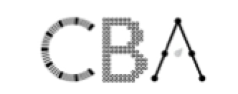
Problem Solving in Large-Scale Assessments A New Area of Focus Samuel Greiff University of Luxembourg
Notes:
Shortly introduce myself
It is an honour to present here to you

Slide 2
Increase in demands
Collaborative tasks
62
21st century skills
60
Complex non-routine tasks
58
56
54
52
50
48
1960
1970
1980
1990
2000
2017
46
44
Manual &
routine tasks
42
40
38
Decrease in demands
Autor, Levy, & Murnane (2003)
Notes:
The world is changing, and so are the skills that we need
Paying attribute to the changes in the world…

Slide 3
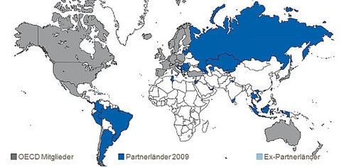
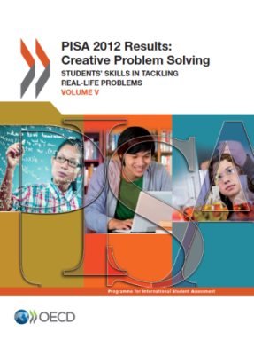
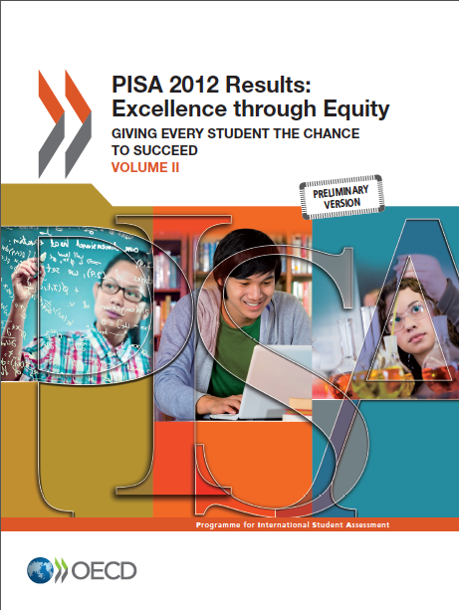
Problem solving as 21st century skill
PISA 2003: Analytical Problem Solving
ALL 2005: Problem Solving
PISA 2012: Creative Problem Solving
PIAAC Cycle 1: Problem Solving with Technology (PS-TRE)
PISA 2015: Collaborative Problem Solving
To come
PIAAC Cycle 2: Adaptive Problem Solving
Notes:
Problem solving has been considered important for a very long time
In different ways and specific attributions…
New concept in PIAAC cycle 2

Slide 4
PIAAC
Programme for the International Assessment of Adult Competencies
Adult population aged 16 to 65
Cycle 1 in 2012: Literacy, Numeracy, PS-TRE
Cycle 2 in 2021: Literacy, Numeracy, APS
Notes:
PIAAC is the adult version of PISA
PISA better known and more widely distributed

Slide 5
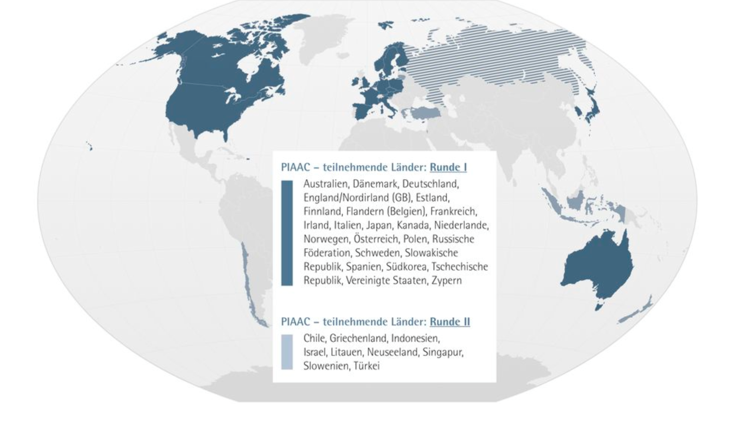
Notes:
German slide, but you see here participating countries in Cycle 1

Slide 6
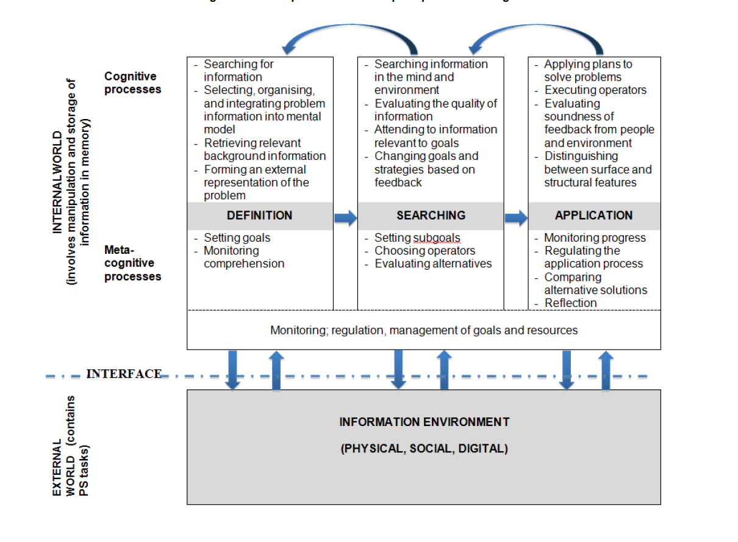
Greiff et al., 2017
Notes:
Talk about:
The stages
The processes also Monitoring
The internal world, the external world, the interface

Slide 7
APS - A “tool” with different facets
Defining
Searching
Application
Cognition
Meta-Cognition
Monitoring
Greiff et al., 2017

Slide 8
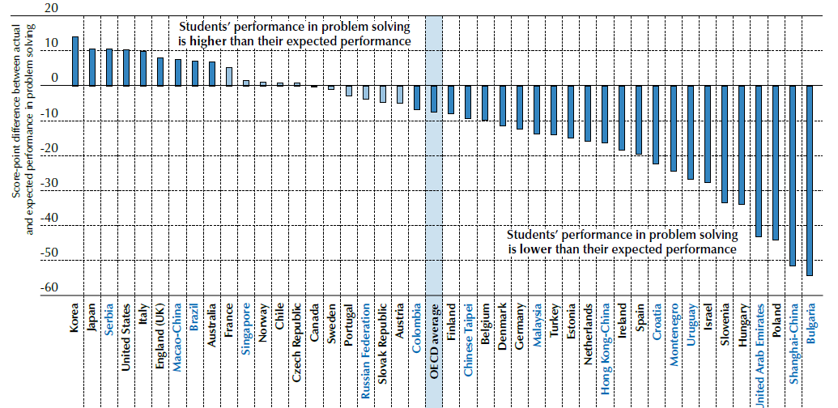
Underperformers in Problem solving
Notes:
Interesting results from problem solving: under- and overperformers

Slide 9
Problem solving: revealing hidden potential in disadvantaged populations
PISA: weaker link with SES
Notes:
PS in 80% of the countries less strongly associated with SES compared to the other domains
Example of the USA
Almost 50% less
Problemlösen fast in allen Ländern nicht so sehr mit SES assoziiert als Performanz in anderen Fächern, so auch in USA!
Dieses Ergebnis gilt für mehr als 80% der beteiligten Länder.
Detailliertere Infos:
In general, the strength of the association between performance and socio-economic status, measured as the percentage
of variation in performance explained by socio-economic disparities, is similar for mathematics (the OECD average
is 14.9%), reading (13.2%) and science (14.0%). Interestingly, Figure V.4.9a shows that this relationship is weaker
in problem solving than in the three other domains. Still, even in problem solving, about 10.6% of the variation in
performance can be explained by differences in socio-economic status; and on average, a one-unit increase in the ESCS
index is associated with a score difference of 35 points in problem solving (Table V.4.13).
As exceptions to this pattern, in the Czech Republic and Turkey, as well as in partner countries/economies Brazil, Malaysia,
the Russian Federation, Serbia and Shanghai‑China, the impact of socio-economic status on performance is as strong in
problem solving as in mathematics. In no country, however, is the impact of socio-economic status stronger on problem
solving than on mathematics performance (Figure V.4.9a and Table V.4.13).

Slide 10
Help
students to…
deal with unexpected situations
Explicate relations to other problems (across domains)
Help establish general mental representations („templates“)
Peer/Group learning
Facilitate transfer
set up and test general hypotheses
discover similarities across problem situations and subjects
“Good education is giving students multiple opportunities to find things out by themselves.”
Notes:
- Talk about hidden curricula (primary, secondary, and tertiary education)

Slide 11
Educationalists
Policy
makers
Scientists
11
Notes:
Efforts needed to have a sustainable impact

Slide 12
Contact
Prof. Dr. Samuel Greiff
samuel.greiff@uni.lu
Research Area Group "Computer-Based Assessment“
11, Porte des Sciences
4366 Esch, Luxembourg
Phone: +352-466644-9245

